Slide 1
How to Claim Carry Over Points from Your Previous Continuing Competence Reporting Period
The NC Board of PT Examiners Board Rule on carry over points:
21 NCAC 48G .0106 CONTINUING COMPETENCE REQUIREMENT
(c) Up to 10 extra points earned during one reporting period may be carried over to the next reporting period, except that points earned for the Jurisprudence Exercise, Clinical Practice and Self-Assessment categories may not be carried forward.
For additional questions or further assistance, send an email to PTBoard@ncptboard.org and note “Continuing Competence Question” in the subject line.

Slide 2
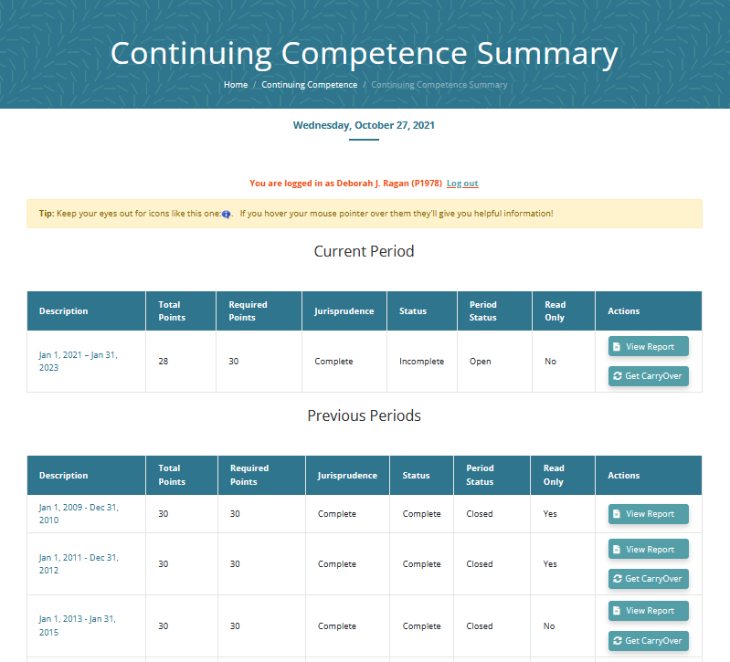
Continuing Competence Summary Page
Log in to your Continuing Competence
Summary page to claim your carry over
points, or to see if you have any eligible
carry over points.
Click on the Get CarryOver button (red arrow).

Slide 3
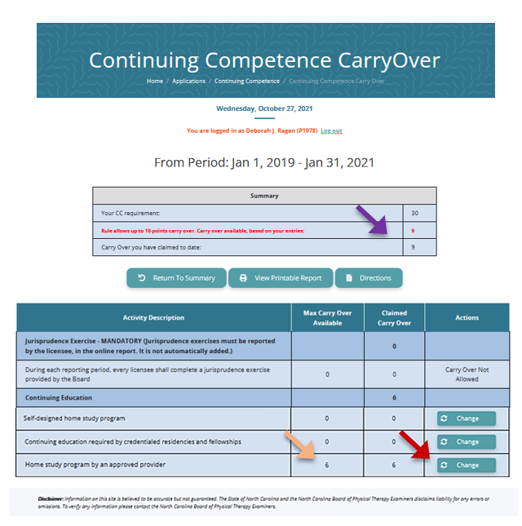
Continuing Competence Carry Over Form
 This screen displays available carry over points (purple arrow).
 The next table shows the category or categories with carry over points available to use.
In this case, the only carry over points available are in the “approved home study” category.
⬥ Click on the Change button (red arrow).

Slide 4
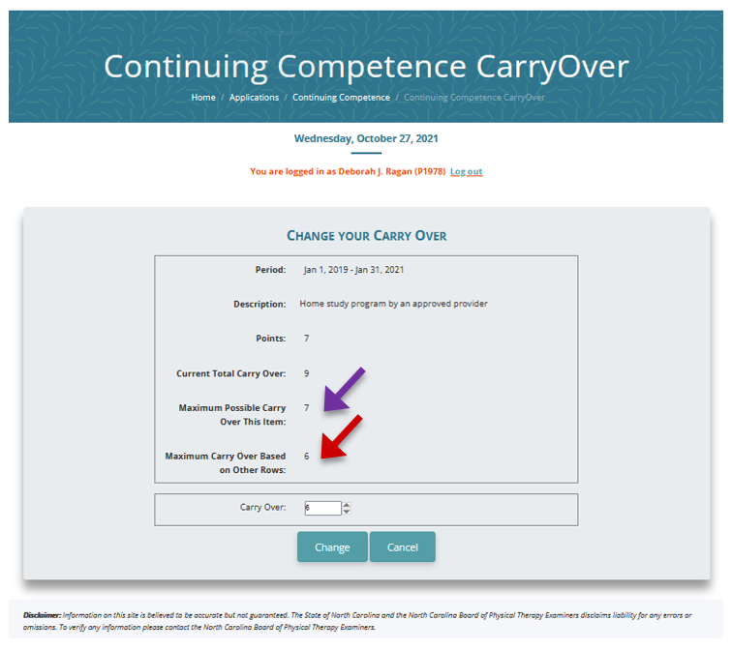
Change Carry Over Hours Screen
 This screen allows you to claim your carry
over points.
In this example, there are 7 points available and 6 points maximum to claim as carry over points.
In the Carry Over box (green arrow) enter the number of hours needed.
⬥ Click the Change button.

Slide 5
Your Carry Over hours have been processed!
⬥ If you need assistance, send an email to PTBoard@ncptboard.org and note “Continuing Competence Question” in the subject line.

